Slide 1
Unlocking the Power of Sun: Current Regulatory Hurdles & Way Forward
Anjal Niraula
CEO
Gham Power Nepal Pvt. Ltd
26th Feb 2020
Venue: Himalayan Hotel

Slide 2
Agenda
Intros
Energy Supply Systems
Distributed Solar PV systems
Renewable Energy Service Companies (RESCO’s)
Regulatory Ambiguities
Way Forward

Slide 3
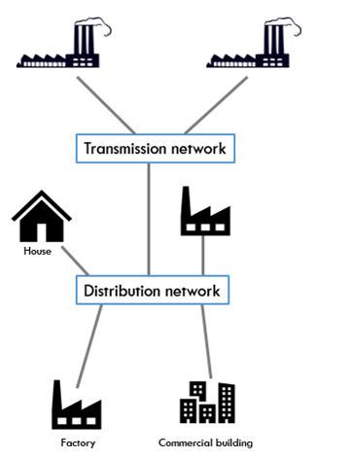
Understanding Energy Supply Systems: Centralized model
Linear power flow
Generation far away from customers
Few but large sized generators
Economies of scale
Cheap electricity for most of history

Slide 4
Issues with the centralized model
High technical losses
Management of new distributed loads
Electric vehicles
Induction heating replacing LPG
Managing the transition to a smart grid – with actions both in front of and behind the meter
High investment in transmission and distribution
Voltage droops and surges at the grid edge

Slide 5
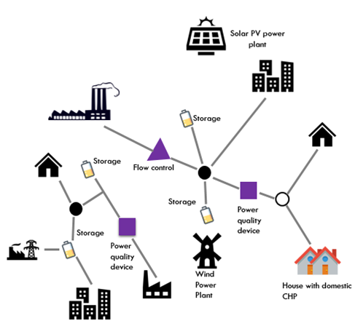
Distributed systems
Multiple power pathways
Generation close to the customer
Usually < 1 MW

Slide 6
Distributed solar PV systems
Demand driven
Modular
Reduction in solar prices → can now offer prices cheaper than the grid
Speed of execution
With or without storage

Slide 7
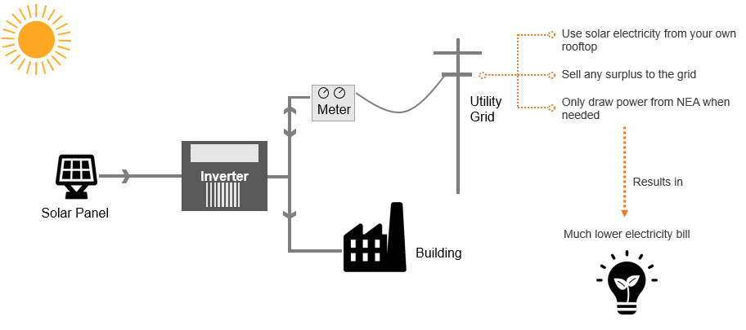
Distributed solar generation: solar rooftops

Slide 8
Digitization of distributed solar
Improve the efficiency of the system and reduce costs using:
Direct electricity trading, in real time, between local generators / users / prosumers in a local market
Current Gham Power research shows that P2P trading reduces peak power flows by 50%
Cost to the consumer reduces by 8.5%
Manage local storage
Balance local renewables
Provide network services (flexibility, response , VAr )
Virtual Power plants (VPP’s)

Slide 9
RESCO’s
Different than just a EPC (Engineering Procurement Commissioning) provider
An entity that develops a project
Finances the project
Collects a fee for the energy produced
Provides long term Operation & Maintenance (O&M) support
Owns multiple aggregated assets
Entities that can create ancillary services for effective grid management

Slide 10
Regulatory uncertainties
LEGAL COMPLIANCE | COMMENTS | MITIGIATION STEPS
Formation of an RESCO | An RESCO is not recognized under the current Electricity laws. A separate industry certificate is needed at Department of Industry each time a new project is registered. Aggregation of multiple projects under a single company is difficult under the existing laws. | Clearly define an RESCO and accept it as an aggregator of projects
Project Licensing | There is no clarity for licensing of the projects in regards to the following: Procedure of obtaining license for projects under 3 MW through local level entities. If separate license has to be obtained for cluster projects, like project as planned by an RESCO. If an RESCO has to obtain only generation license or both, generation and distribution license. | Captive power plants have been defined in the current Electricity Act and such plants are exempt from licensing requirements. But, the definition is limited for systems installed by an owner for their own consumption. System deployed by third party RESCO’s need to be classified as Captive Projects also.
PPA tariffs | There is no clarity on the matter if each electricity rates with each individual should obtain approval from Electricity Regulatory Council(ERC). | Coordinating with ERC to obtain clarity on the matter. Organizing a presentation for Department of Energy Development (DOED) and ERC employees for their better understanding of the business plan.

Slide 11
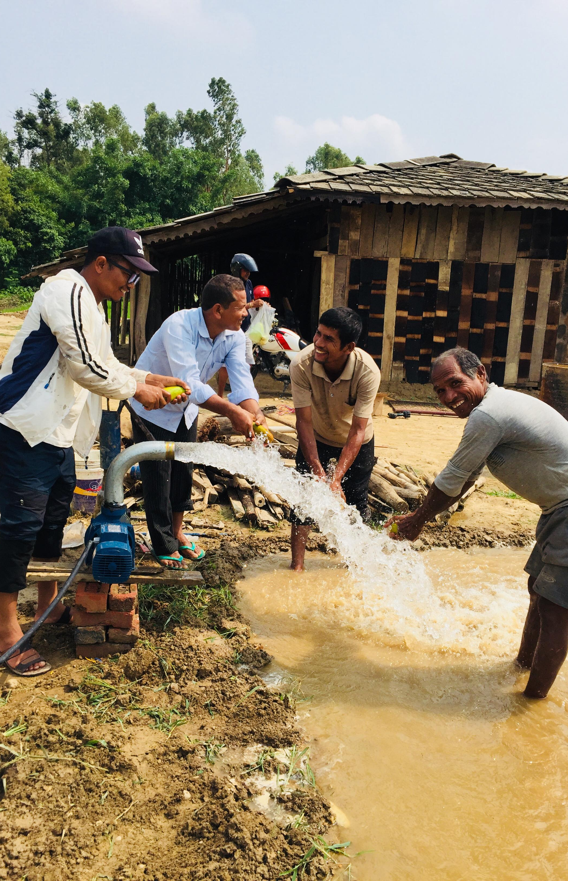
Thank You!
anjal@ghampower.com
www.ghampower.com

